Slide 1
Homework 4
Apostolopoulou Ioanna
Toloudis Panagiotis

Slide 2
Environment
Run
Runs programs requested and places them in groups
List
Prints all running processes and threads at the momet in the Workspace
Kill
Kills all process in group requested
Migrate
Takes a process form 1 machine to another by sending its data over network
Help
Prints instructions on how to use our workspace

Slide 3
Parser
Opens files requested to run
Checks from line 0 to end of file for syntax errors
If syntax errors are found terminates the procedure.
If loop in labels is detected, exits the runing program with error code.

Slide 4
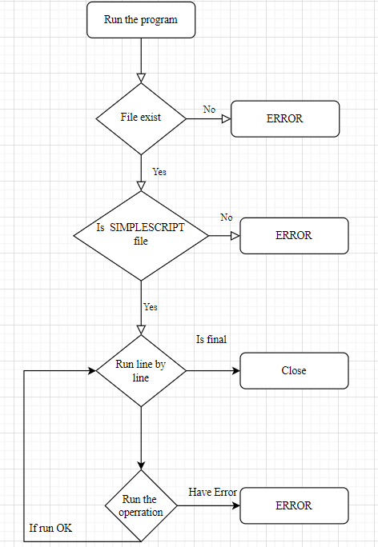

Slide 5
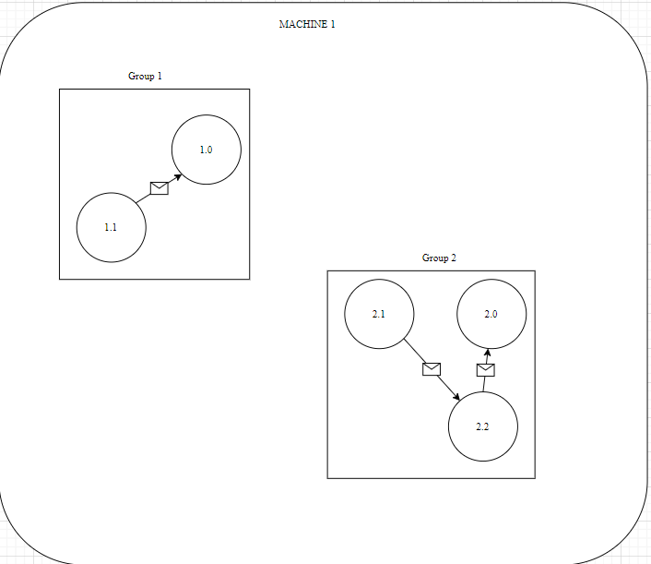

Slide 6
MIGRATION
THE MIGRATION FROM ONE MACHINE TO OTHER IS DONE BY :
Tcp/ip protocol
User defines the ip and port for the new host machine
Messages sent between menbers of the same group in which some processes migrated into other machine :
Find the machine that hosts the process by using multicast
Sends message or data over tcp/ip protocol

Slide 7
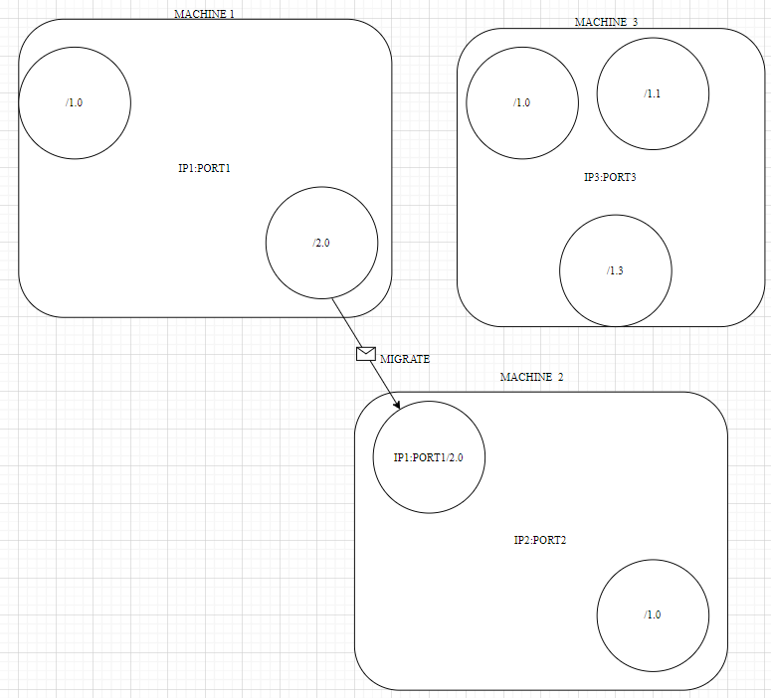

Slide 8
Load balance (Theoretically)
1 machine is defined as the co-ordinator
Sends a multicast request to every active machine runing the workspace asking for their load
When data are collected places them into a global distributed buffer that every machine has access to
Buffer is consisted of the name_of_machine (ip.port) and the counter of load
Sum of loads is calculated
And then the average number of processes per machine is calculated
THEN THE CO-ORDINATOR INFORMS EACH MACHINE OF THE MIGRATIONS NEEDED TO BE DONE SO IT IS BALANCED

